Slide 1
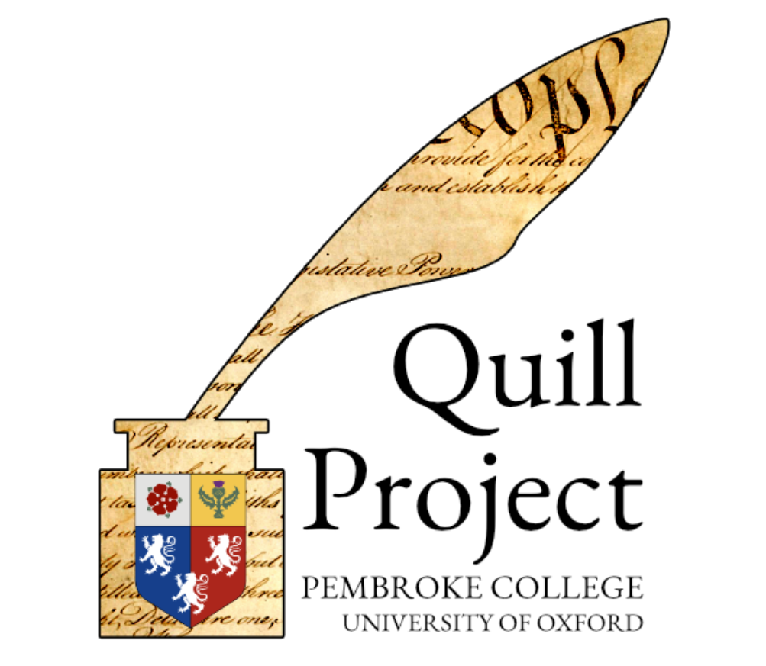
The Quill Project
Understanding how constitutions and laws are written
Quill exists to enhance understanding of some of the foundational legal texts of the modern world.
The project is directed by Dr. Nicholas Cole, a political historian specializing in post-Independence America.
The project is based at Pembroke College, University of Oxford.
Notes:
This is done by researching and modeling the context within which constitutional conventions, legislative assemblies, and other formal groups make decisions.
He operates across the fields of humanities, computer science, and the social sciences.
and enjoys a strategic partnership with us at the Center for Constitutional Studies at Utah Valley University.

Slide 2
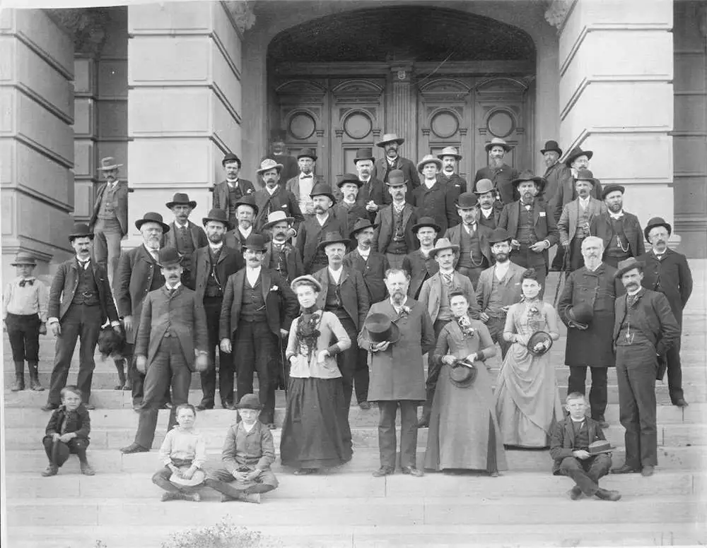
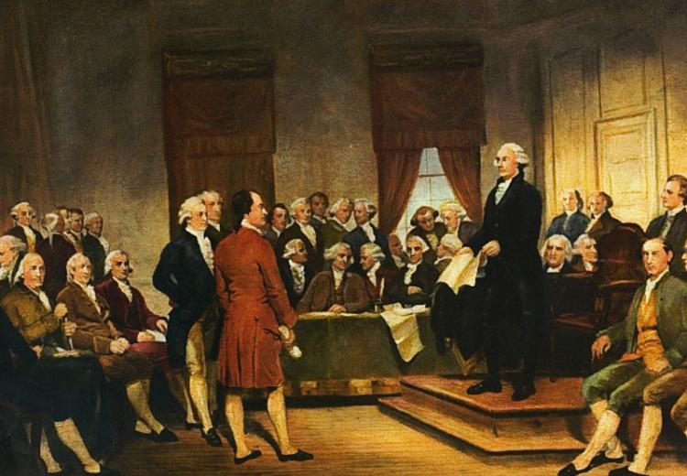
Structure of the Convention
Notes:
Conventions are organized in the same way legislatures are
Representatives from geographical areas
Elected leadership, President serving as a majority leader or speaker role- Melvin C. Brown, lifelong lawyer and judge
The structure contains Committees and chairs in which the debates and amendment process comense.

Slide 3
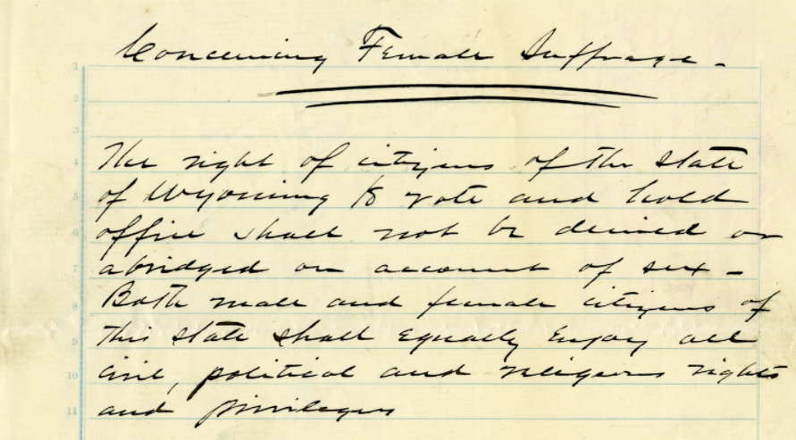
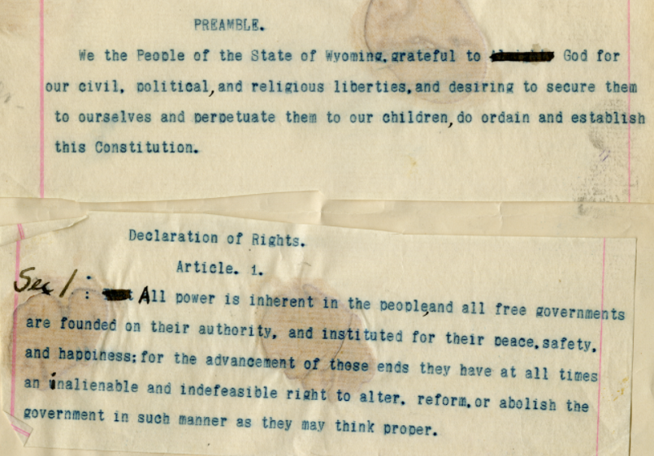
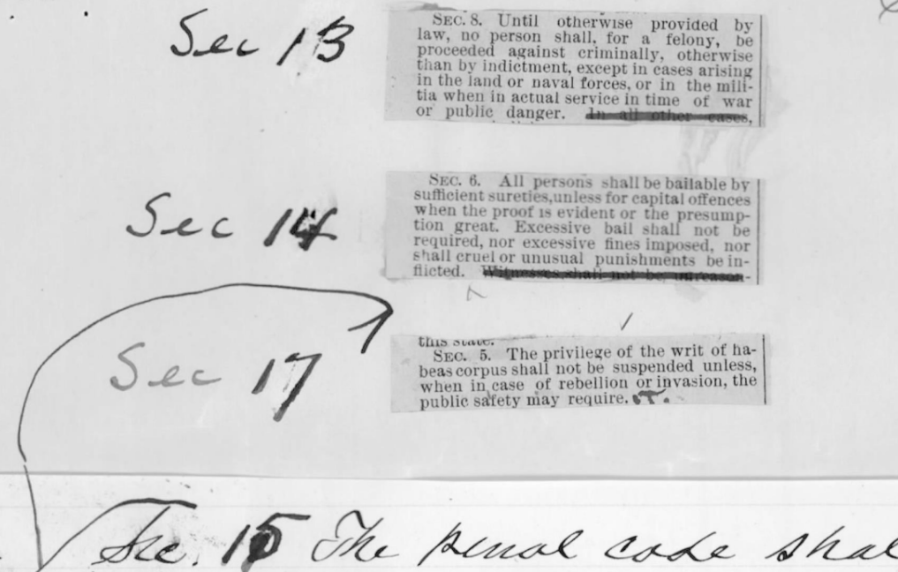
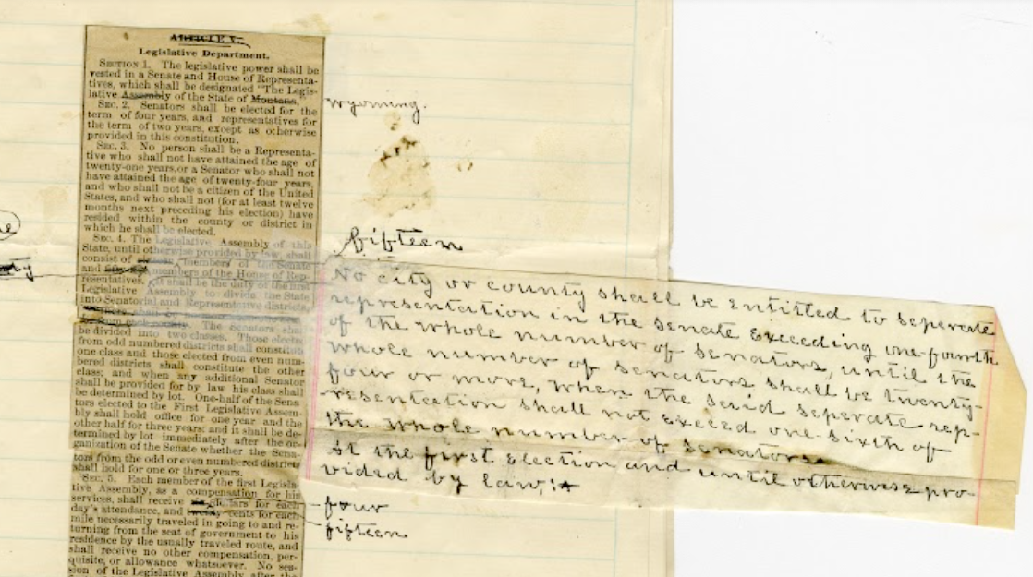
Notes:
Show Dr. Cole intro video up to 3:25 (found on https://quillproject.net/m2/getting_started/)

Slide 4
Notes:
The basis of What is a Constitutional Convention?
Meeting held to create constitution
Enabling act
Election of delegates?
Debate provision, and creation of language
Approval Vote on Final Draft
Ratified by Voters
Then within the Quill platform us researchers build the convention. Creating the convention and committees, adding the delegates and further depicting the chronological organization that the journal conveys to the final constitution.
Diamonds are decisions
Hexagon are procedures
Circles are people
Squares are documents

Slide 5
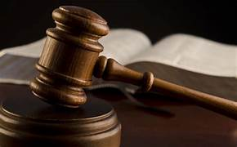

Slide 6
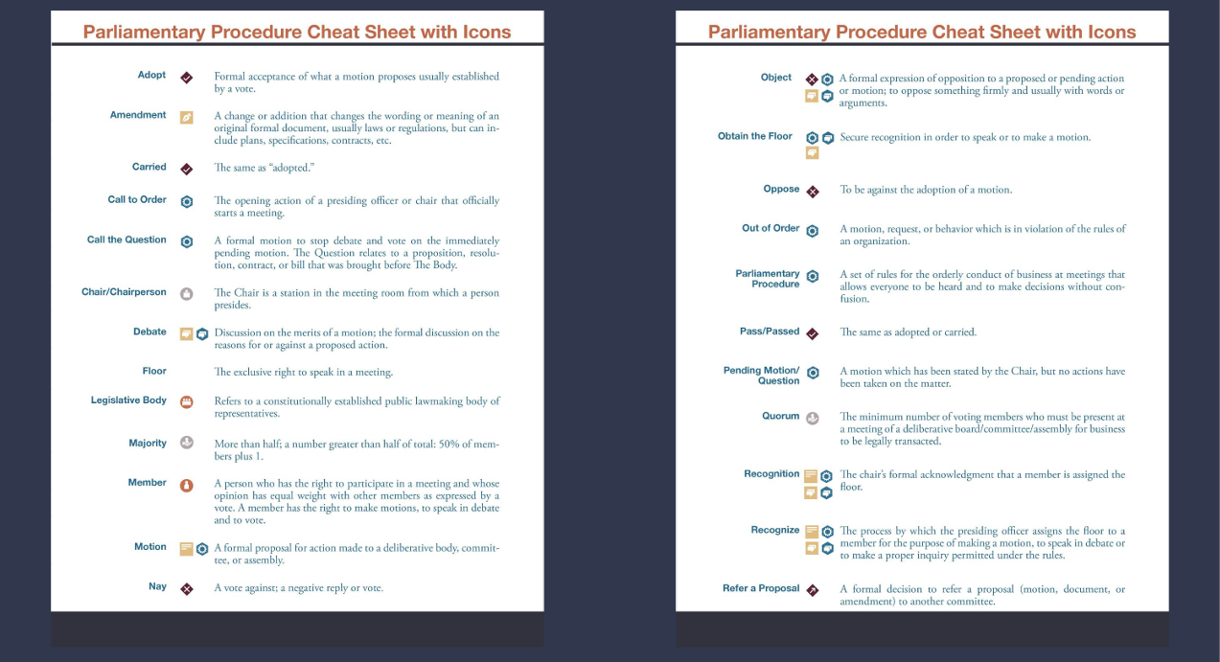

Slide 7
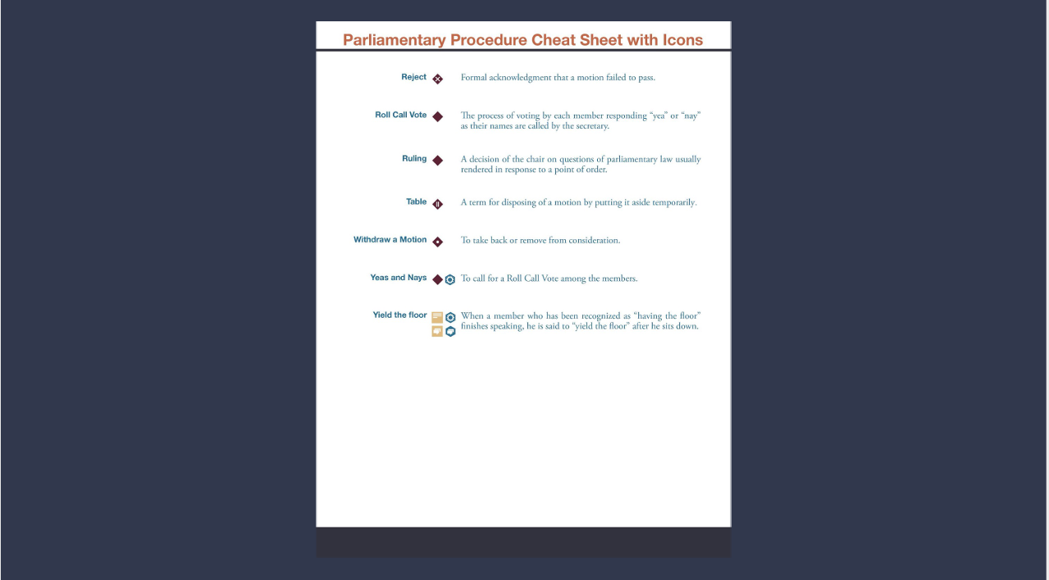

Slide 8
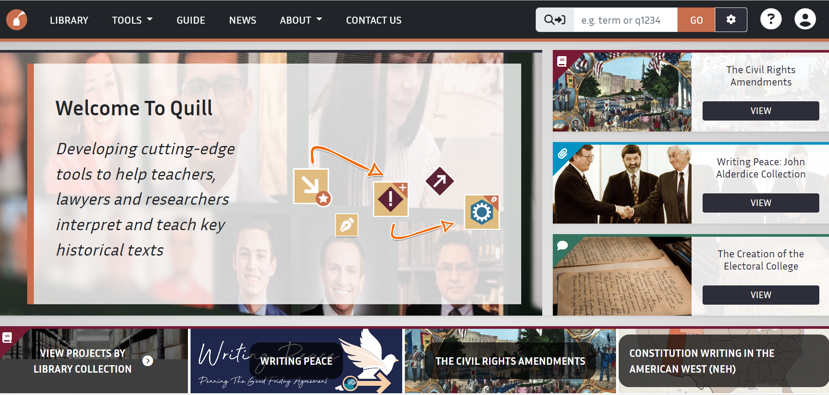
Live Quill: https://quillproject.net/m2/

